Slide 1


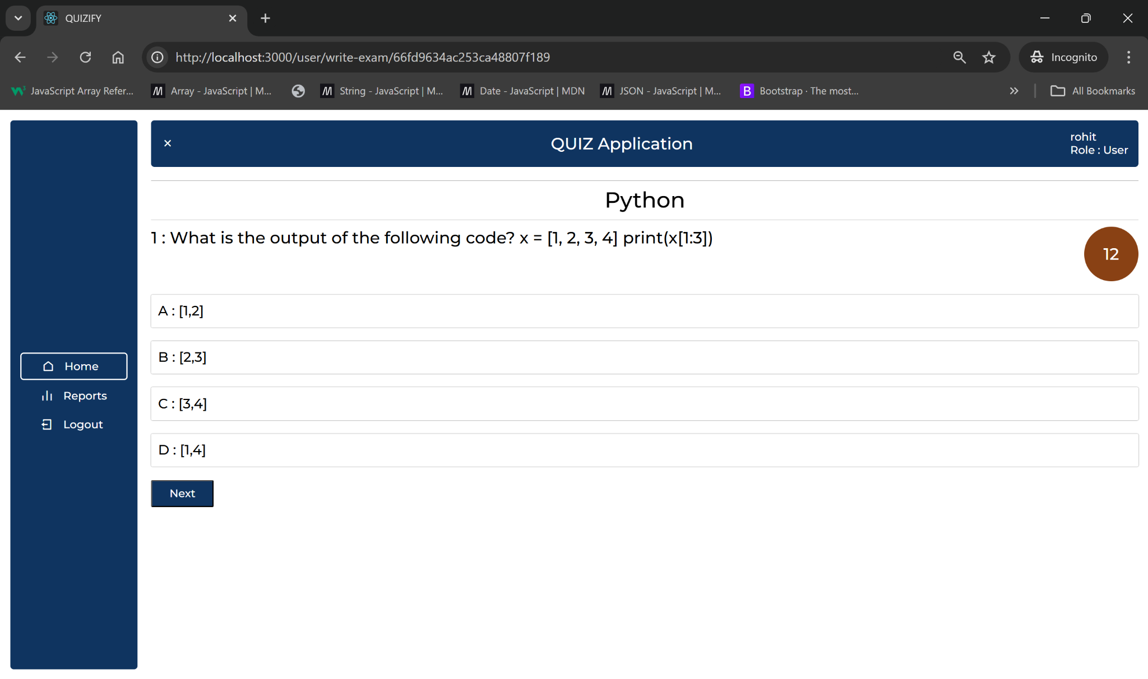
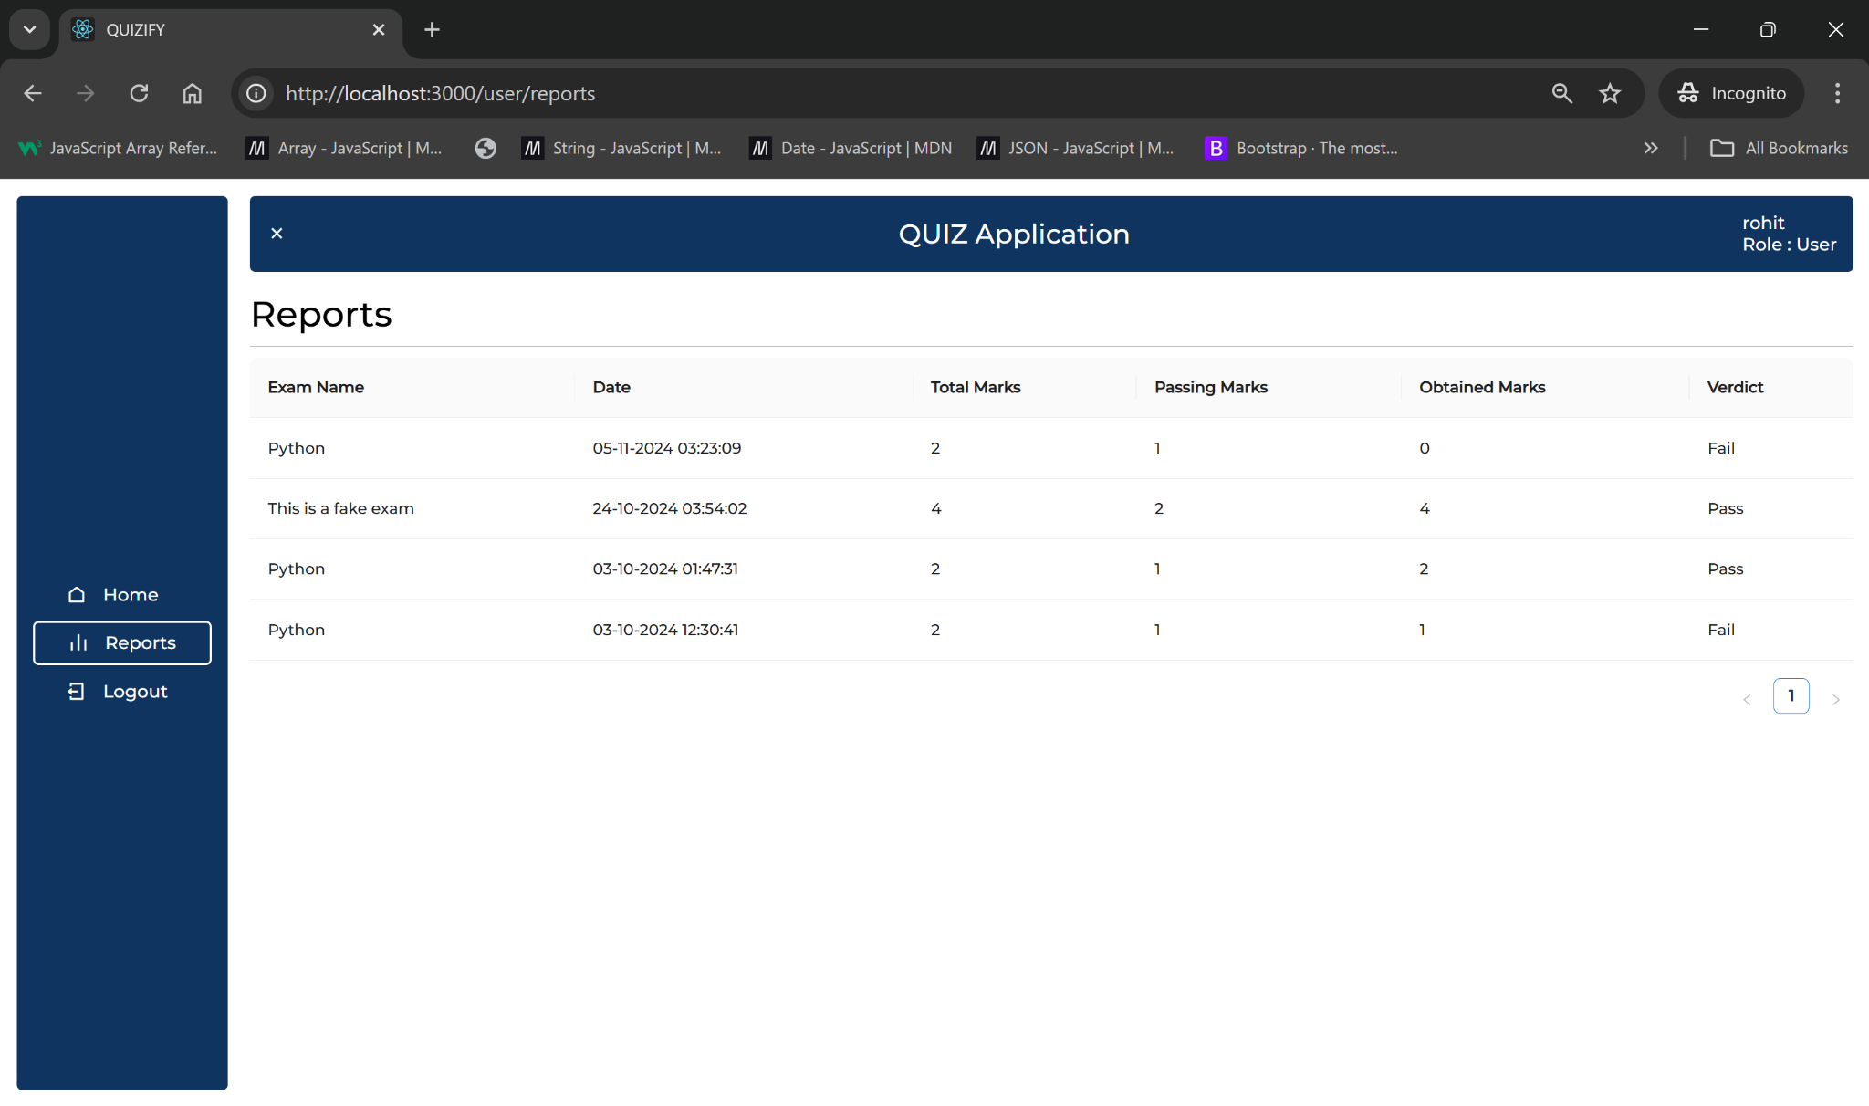
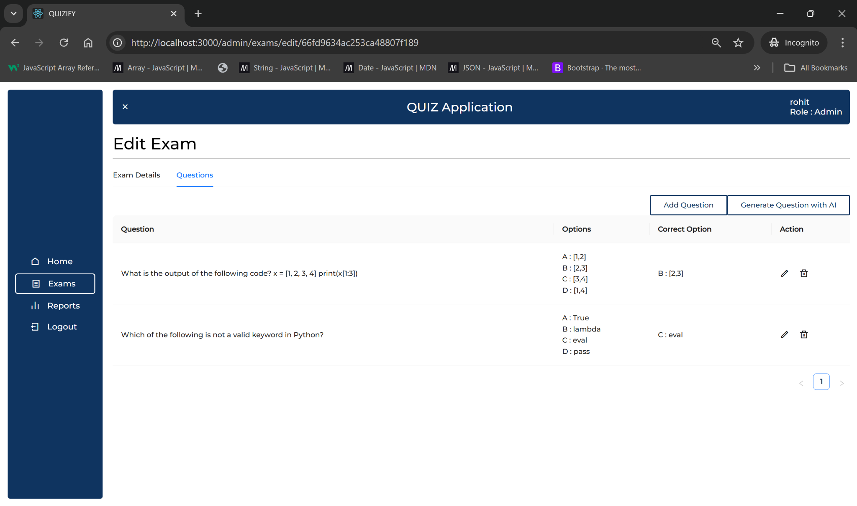
FACULTY OF ENGINEERING & TECHNOLOGY K J SOMAIYA SCHOOL OF ENGINEERING DEPARTMENT OF COMPUTER ENGINEERING
Title: Quizify: AI-Powered Quiz Application
Student Name: Peeth Chowdhary, Rohit Deshpande
Under the guidance of : Prof. Mrs. Smita Sankhe
Course Name: FSD - MERN Year: 2024-25
Introduction
An innovative AI-powered quiz application designed to offer personalized quizzes based on topic preferences. It caters to students by providing targeted questions for self-assessment and improvement, while enabling educators to manage quizzes, monitor progress, and assess performance.
AI Integration
By utilizing the Gemini API, Quizify dynamically generates contextually relevant questions, enhancing the learning experience through personalized content.
Implementation
User Registration & Authentication: Secure profile creation using bcrypt for password hashing and JWT for authentication, ensuring data privacy and integrity.
AI-Powered Dynamic Question Generation: Gemini API generates quiz questions on-demand, tailored to user preferences, skills, and selected topics.
Quiz Tracking & Data Storage:
Quiz Storage: Each quiz attempt and user response is securely stored in MongoDB.
Progress Tracking: Users can review past quizzes and track their performance history.
Educator Dashboard: Educators can create quizzes, assign them to students, and monitor performance through an analytics dashboard with detailed metrics.
Technology Stack
Frontend:
React.js for UI components and dynamic content rendering.
CSS & HTML for styling and layout.
Axios for smooth API integration and handling data requests.
Backend:
Node.js & Express.js for server-side logic and routing.
Database:
MongoDB for NoSQL storage, designed to manage quizzes, users, and performance data.
Additional Tools:
Mongoose for MongoDB schema modeling and data validation.
JWT and bcrypt for secure user login and authentication.
Gemini API for personalized AI-powered question generation.
Results
Objective
Create a smart, interactive quiz platform that adapts to individual skill levels, supports varied topics, and assists educators in managing quizzes and tracking student progress.
Primary Users:
Students: Access customized quizzes that match their learning needs.
Educators: Easily create and assign quizzes, analyze performance data, and download reports.
System Design
Frontend: Developed with React.js for a responsive user interface.
Backend: Built using Node.js and Express.js, managing APIs and user data.
Database: MongoDB stores user profiles, quizzes, and performance data, with indexing for optimized retrieval.
AI Integration: Gemini API generates contextually relevant questions based on user profiles and interests.
Testing Results
API Latency: Caching frequently requested topics and preloading common ones minimized delays, with robust error handling for uninterrupted quiz delivery.
Database Efficiency: Indexed essential fields (user IDs, exam IDs, question IDs) to improve retrieval speed for quizzes and reports.
Data Consistency: Standardized API responses and Axios interceptors resolved data flow issues between frontend and backend.
Gemini API Optimization: Fine-tuned API key usage and response handling for timely, relevant question generation, ensuring efficient AI-driven personalization.
Figma: Link
Github: Link
Notes:
Copyright Colin Purrington (http://colinpurrington.com/tips/academic/posterdesign).
‹#›

